Slide 1
A Seminar on Secure Passwords with Hidden Information and Non-Exposure
Team Details
S Sai Kumar- 20EG105346
V Chandan Teja-20EG105353
M Shyamsunder - 20EG105360
Project Supervisor
Dr. T. Shyam Prasad
Assistant Professor

Slide 2
Introduction
SPHINX is an innovative password management system designed for heightened security, even in the event of the password manager being compromised. The stored information on the device remains independent of the user's master password, ensuring an added layer of protection. Notably, the master password is never exposed in plaintext during device interaction, preventing potential leaks to attackers. SPHINX generates high-entropy passwords and mandates users to register them with web services, effectively thwarting online guessing attacks and offline dictionary attacks upon service compromise.

Slide 3
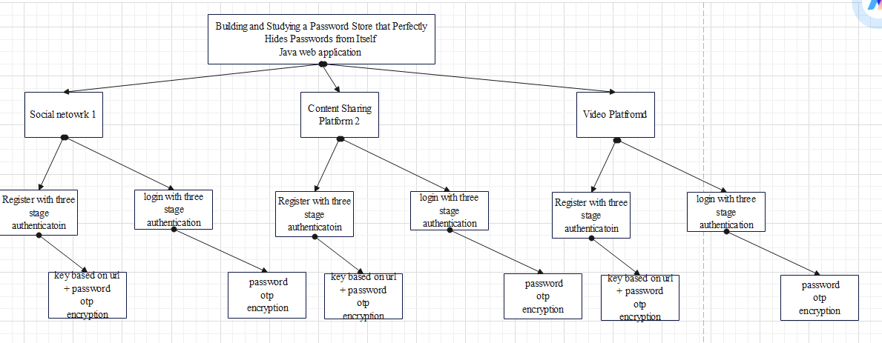
Concept Tree

Slide 4
Literature
SI.NO | Strategies | Advantages | Disadvantages
1 | On the security of cracking-resistant password vaults. | investigate the construction of encrypted vaults that resist such offline cracking attacks and force attackers instead to mount online attacks | A password vault can greatly reduce the burden on a user of remembering passwords, but introduces a single point of failure
2 | Round-optimal password-protected secret sharing and T-PAKE in the password only model | the system is secure against offline password attacks by an attacker controlling up to t servers | Time taking and require sever authentication
3 | Device Enhanced Password Protocols with Optimal Online-Offline Protection. | An attacker taking over the device still requires a full online attack to impersonate the user. | Hardware device is required for using this method.

Slide 5
Literature
4 | A Comparative Usability Evaluation of Traditional Password Managers | users were not comfortable giving control of their passwords to an online entity and preferred to manage their passwords themselves on their own portable device | Use apps to manage user passwords which is not secure
5 | Cracking resistant password vaults using natural language encoders. | a new type of secure encoding scheme that we call a natural language encoder (NLE). An NLE permits the construction of vaults which, when decrypted with the wrong master password, produce plausible looking decoy passwords. | Use automated NLP technique which is defied by system
6 | The emperor’s new password manager: Security analysis of web-based password managers | We identify four key security concerns for web-based pass- word managers and, for each, identify representative vulnerabilities through our case studies | Data analysis on various attacks is performed

Slide 6
Literature(cont..) selected strategy:
SI.NO | Author | Strategies | Advantages | Disadvantages
1. | M. Gollam, B. Beuscher, and M. Durmuth | NLE-based cracking-resistant vault system called No Crack. | investigate the construction of encrypted vaults that resist such offline cracking attacks and force attackers instead to mount online attacks | A password vault can greatly reduce the burden on a user of remembering passwords, but introduces a single point of failure
2. | S. Jarecki, A. Kiayias, and H. Krawczyk. | a Password-Protected Secret Sharing (PPSS) scheme | the system is secure against offline password attacks by an attacker controlling up to t servers | Time taking and require sever authentication

Slide 7
Literature(cont..) selected strategy:
3. | S. Jarecki, H. Krawczyk, M. Shirvanian, | DE-PAKE scheme | An attacker taking over the device still requires a full online attack to impersonate the user. | Hardware device is required for using this method.
4. | A. Karole, N. Saxena, and N. Christin | KeePassMobile scheme | users were not comfortable giving control of their passwords to an online entity and preferred to manage their passwords themselves on their own portable device | Use apps to manage user passwords which is not secure
5. | Z. Li, W. He, D. Akhawe, and D. Song. | NLE-based cracking-resistant | a new type of secure encoding scheme that we call a natural language encoder (NLE). An NLE permits the construction of vaults which, when decrypted with the wrong master password, produce plausible looking decoy passwords. | Use automated NLP technique which is defied by system

Slide 8
Problem Statement
An attacker breaking into a server can mount an offline attack that uses information stored on the server to test the different passwords in the dictionary. Such offline dictionary attacks are an increasingly important concern, especially in light of frequent attacks against major commercial vendors, as recently experienced, e.g., by PayPal, LinkedIn, Blizzard and Gmail. The offline attacks are particularly devastating as a single server break in may lead to extraordinary numbers of compromised passwords

Slide 9
Problem Statement
Existing Method:
Cracking-resistant password encoding strategies have been proposed in the literature to render offline dictionary attacks ineffective. They introduce the notion of out putting decoy passwords to an attacker who compromises the manager and attempts to decrypt the passwords with a wrong master password. Since the attacker is not aware of the correct password, any attempt to login with the decoy passwords can be prevented on the server, and raise an alert.

Slide 10
Problem Statement
Disadvantage:
However, such a scheme seems to be vulnerable to an attack presented in existing work, based on differences in the distribution of the passwords.
Pwd Hash deterministically transforms a user’s password into a more complex password but this transformation does not protect against offline dictionary attacks at a compromised web service.

Slide 11
Problem Illustration
Numerous approaches have been proposed by re searchers and practitioners to improve the security of pass words from the client-side or user-side alone (i.e., without making any changes to a persistent server that uses traditional password-based authentication). One broad class of such approaches is referred to as password managers and forms the central focus of this project.

Slide 12
Problem Illustration
Dependency on Device:
Passwords stored locally on a device may lead to issues if the device is lost, stolen, or compromised.
Lack of synchronization across devices can result in inconvenience for users.
Single Point of Failure:
In the event of a master password breach, the entire password vault becomes vulnerable.
Trust in Third-Party Providers:
Users may be tricked into entering master passwords, compromising the entire password repository.
Limited Protection Against Phishing:
Users must trust the security practices of the chosen password manager provider.

Slide 13
Proposed Method
SPHINX is a compelling application of DE-PAKE. It is a password manager, transparent to any existing service that deploys password authentication in which, U registers a hardened randomized password rwd with S, but only remembers a memorable password pwd that could be the same for multiple accounts (we use the terms master password and memorable password interchangeably).For each server S with which the user U has an account, the device D stores a unique key k. The key is used to map the pwd into a randomized password rwd = Fk(pwd|domain) using the (oblivious) PRF Fk. pwd and rwd are never stored in C and neither rwd nor pwd is ever stored in or exposed to D. Instead, D and C run the PTR protocol to obliviously compute rwd at the login time. SPHINX offers several key security guarantees simultaneously (individually as well as combined).

Slide 14
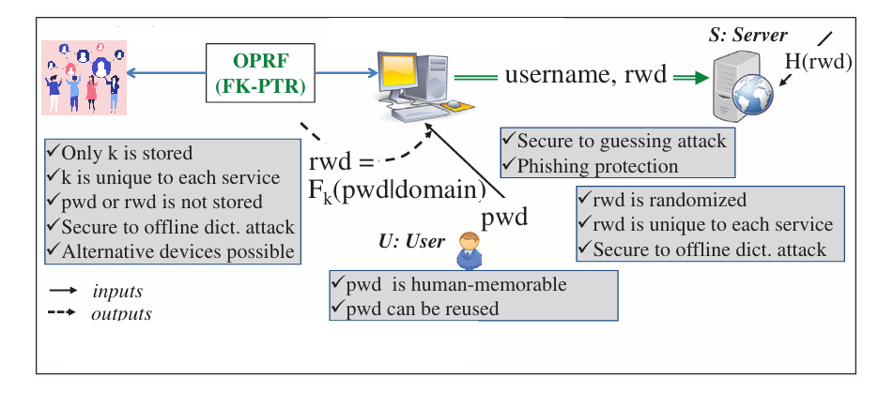
Proposed Method Illustration

Slide 15
Proposed Method Illustration
Application Overview:
SPHINX is a password manager leveraging DE-PAKE (Distributed Enhanced Password Authenticated Key Exchange).
It operates transparently across various services employing password authentication.
User Registration:
During registration, User U establishes a hardened randomized password (rwd) with the server S.
The user only needs to remember a memorable password (pwd), which could be the same for multiple accounts.
Unique Key Mapping:
For each server S, the device D stores a unique key (k).
Oblivious Computation:
At login time, D and C engage in the PTR (Password-Transparent to the Referee) protocol to obliviously compute rwd.

Slide 16
Proposed Method Illustration
5. Key Security Guarantees:
SPHINX offers simultaneous security guarantees:
Password Privacy: Neither rwd nor pwd is stored in or exposed to D.
Key Confidentiality: Unique keys for each server ensure confidentiality.
Resistance to Server Compromise: Even if a server is compromised, individual passwords remain secure.
6.Advantages:
Enhanced Security: Leveraging DE-PAKE ensures robust password management.
Privacy Protection: The protocol ensures that sensitive password information is never stored or exposed.

Slide 17
Parameter
Setup:
Group G. The scheme works over a cyclic group G of prime order q, |q| = τ, with generator g.
Hash functions H, Hmap arbitrary-length strings into elements of {0,1} τ and G, respectively, where τ is a security parameter.
OPRF. For a key k ← Zq, we define function Fk as Fk(x)=H (x, (H(x)) k).
Parties. User U, Client C, Device D, Server S.

Slide 18
Parameter
Initialization Phase:
D chooses and stores OPRF key k ← Zq;
U chooses and remembers a memorable password pwd ← Dict;
C and D interact to construct “randomized password” rwd = Fk(pwd|domain) on input pwd from U and k from D;
Server S stores one-way hash of the “randomized password” rwd
Login Phase :
C chooses ρ ← Zq; sends α =(H(pwd|domain)) ρ to D.
D checks that the received α ∈ G and if so, it responds with β = αk.
C sets rwd = H (pwd|domain, β1/ρ).

Slide 19
Experiment Environment
Front End: HTML, CSS, Java Script.
Back End: Java
Database: MySQL
IDE: NetBeans
NetBeans provides a comprehensive IDE with features tailored for Java development. It offers tools for coding, debugging, refactoring, and project management, streamlining the development process.
NetBeans has built-in support for version control systems like Git, enabling you to manage code changes, collaborate with team members, and track project history effectively.

Slide 20
Project status
S.No | Functionality | Status (Completed /in-progress/Not started)
1. | Literature Survey | Completed
2. | Planning and Design | Completed
3. | Implementation | Not Started
4. | Closure | Not Started

Slide 21
References
M. Gollam, B. Beuscher, and M. Durmuth. On the security of cracking-resistant password vaults. In ACM Conference on Computer and Communications Security, 2016.
S. Jarecki, A. Kiayias, and H. Krawczyk. Round-optimal password-protected secret sharing and T-PAKE in the password only model. In Advances in Cryptology–ASIACRYPT. 2014.
S. Jarecki, H. Krawczyk, M. Shirvanian, and N. Saxena. Device Enhanced Password Protocols with Optimal Online-Offline Protection. http://eprint.iacr.org/2015/1099. ASIACCS 2016.
Karole, N. Saxena, and N. Christin. A Comparative Usability Evaluation of Traditional Password Managers. In International Conference on Information Security and Cryptology, 2010.
R. Chatterjee, J. Bonneau, A. Juels, and T. Ristenpart. Cracking resistant password vaults using natural language encoders. In 2015 IEEE Symposium on Security and Privacy, pages 481–498. IEEE, 2015
Z. Li, W. He, D. Akhawe, and D. Song. The emperor’s new password manager: Security analysis of web-based password managers. In USENIX Security Symposium, 2014.

Slide 22
Thank you

Slide 23
Project seminar–I Evaluation
S.No | Rubrics | Marks
1 | Concept Introduction | 4
2 | Literature and Parameter | 5
3 | Problem and Problem Illustration | 8
4 | Proposed Method and Illustration | 8
Total |  | 25

